Slide 2
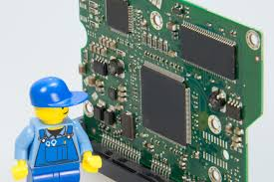
TK1100 Digital Technology
Computer
architecture

Slide 3
Learning objectives covered so far (1)
What is in the computer system
computer assembly and main components
The computer language, alphabet,
The Binary Numbering system.
Notes:
define the terms digital og analog
define the terms system and component and use these in analysis.
define computer
define: bit, nibble, byte, word
use the prefixes: k,M,G,T and binary sense
Binary numbering system

Slide 4
Today: Computer Architecture
Boolean algebra
NOT, AND, OR, XOR
Sequential and combinatorial circuits.
Instruction Set Architecture (ISA).
What instructions?
Word size (number of bits)
Addressing mode
Register
Data formats
What the CPU is suitable of doing
Organization (microarchitecture on CPU).
How data is being moved (buses architecture)
How data is stored, e.g. Cache.
…
Now it is time to learn about computer architecture.
How the computer brain, CPU, in the hardware works with the alphabet.
how the spirit of numbers goes to the body of the computer architecture
Notes:
System design (Next time!)
Chipset (bus and memory controllers)
Memory organization
Virtual memory?
Direct memory access (DMA)
What and how it is connected

Slide 5
Boolean algebra

Slide 6
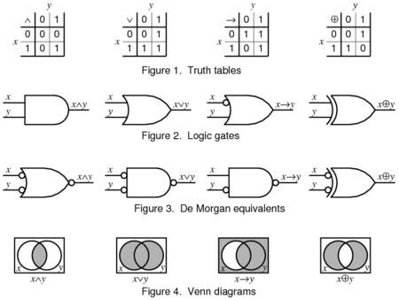
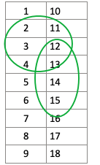
Logic Gates
A logic gate is an idealized model of computation or physical electronic device implementing a Boolean function, a logical operation performed on one or more binary inputs that produces a single binary output.
Notes:
According to De Morgan's theorem, a NAND gate is equivalent to an OR gate with inverted inputs. Similarly, a NOR gate is equivalent to an AND gate with inverted inputs.

Slide 7
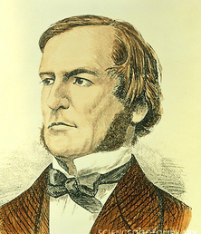
Bit and George Boole
All logic in digital electronics is based on bits
transistors are the building blocks
Can be 0 or 1; high or low voltage.
The logic used is called Boolean Algebra
George Boole (1815-1864)
0 1 1 0 0 1 0 1 1 1 1 0
Note! These 12 bits are normally just a snippet of a 32/64 bit word.
Notes:
What is a flip-flop? It is a kind of circuit that changes back and forth between two states (on and off) at certain intervals. It flips into one state, then flops to another, and so on.
a flip-flop uses number of transistors, for example two transistors, two capacitors, and four resistors to turn the LED on and off.

Slide 8
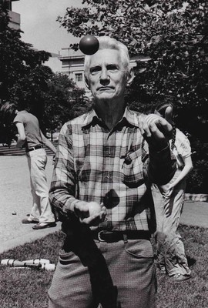
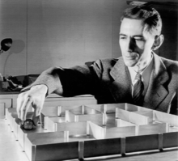
Boolean algebra
Consists of 3 (4) basic operations (gates).
(NOT)
(AND)
(OR)
(XOR)
Rediscovered in 1939 by Claude Elwood Shannon
Computer electronics most often
Prefer «negative» logic
NAND, NOR, XNOR
he tried to solve the maze in one of the first experiments in artificial intelligence.
Notes:
Shannon and his electromechanical mouse Theseus (named after Theseus from Greek mythology)

Slide 9
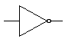
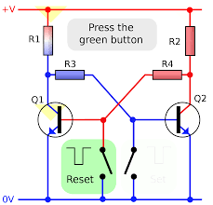
NOT
X
F
Flip-flops and latches are fundamental building blocks of digital electronics systems.
Flip-flops and latches are used as data storage elements.
A flip-flop is a device which stores a single bit (binary digit) of data
10010110
0
1
0
01101001
1
NOT
Truth table
X F
0 1
1 0
https://upload.wikimedia.org/wikipedia/commons/a/a5/Transistor_Bistable_interactive_animated-en.svg

Slide 10
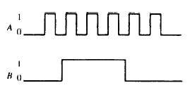
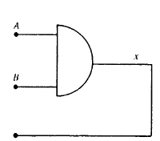
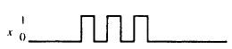
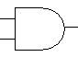
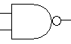
AND and NAND
10010101
1
X
X
F
10000100
F
Y
0
Y
0
10101100
AND NAND
X Y F X Y F
0 0 0 0 0 1
0 1 0 0 1 1
1 0 0 1 0 1
1 1 1 1 1 0

Slide 11
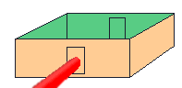
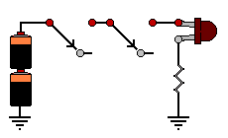
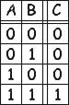
Example: AND

Slide 12


OR and NOR
10111001
X
X
F
10111111
F
Y
Y
10001110
OR NOR
X Y F X Y F
0 0 0 0 0 1
0 1 1 0 1 0
1 0 1 1 0 0
1 1 1 1 1 0

Slide 13
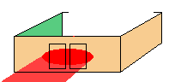
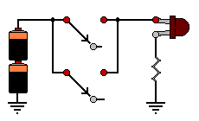
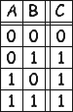
Example: OR

Slide 14


XOR and XNOR
10110010
X
X
F
F
01111100
Y
11001110
Y
XOR XNOR
X Y F X Y F
0 0 0 0 0 1
0 1 1 0 1 0
1 0 1 1 0 0
1 1 0 1 1 1

Slide 15
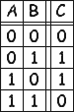
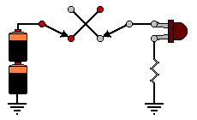
Example: XOR

Slide 16
Examples of Boolean algebra using binary system computer arithmatics

Slide 17
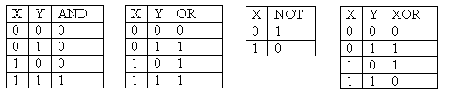
Binary Operations
We learn the binary operations using truth tables
Given two bits, apply the operator
1 AND 0 = 0
1 OR 0 = 1
1 XOR 0 = 1
Apply the binary (Boolean) operators bitwise (in columns) to binary numbers as in
10010011 AND 00001111 = 00000011

Slide 18
Examples
AND – if both bits are 1 the result is 1, otherwise 0
11111101 AND 00001111 = 00001101
01010101 AND 10101010 = 00000000
00001111 AND 00110011 = 00000011
OR – if either bit is 1 the result is 1, otherwise 0
10101010 OR 11100011 = 11101011
01010101 OR 10101010 = 11111111
00001111 OR 00110011 = 00111111
NOT – flip (negate) each bit
NOT 10101011 = 01010100
NOT 00001111 = 11110000
XOR – if the bits differ the result is 1, otherwise 0
10111100 XOR 11110101 = 01001001
11110000 XOR 00010001 = 11100001
01010101 XOR 01011110 = 00001011

Slide 19
Binary Addition - (to remember)
To add 2 bits, there are four possibilities
0 + 0 = 0
1 + 0 = 1
0 + 1 = 1
1 + 1 = 2 – we can’t write 2 in binary, but 2 is 10 in binary, so write a 0 and carry a 1
To compute anything useful (more than 2 single bits), we need to add binary numbers
This requires that we chain together carrys
The carry out of one column goes to be added in the other column to its left

Slide 20
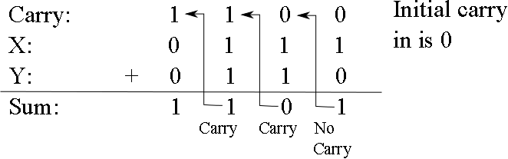
Binary Addition Continued
With 3 bits (the two bits plus the carry), we have 4 possibilities:
0 + 0 + 0 = 0
2 zeroes and 1 one = 1
2 ones and 1 zero = 2 (carry of 1, sum of 0
3 ones = 3 (carry of 1 and sum of 1)
Example:
Check your work, convert to decimal!

Slide 21
Addition Using AND, OR, XOR
To implement addition in the computer, convert addition to AND, OR, NOT and XOR
Input for any single addition is two binary numbers and the carry in from the previous (to the right) column
For column i, we will call these X_{i}, Y_{i} and C_{i}
Compute sum and carry out for column i (S_{i}, C_{i+1})
S_{i} = (X_{i} XOR Y_{i}) XOR C_{i}
Example: if 1 + 0 and carry in of 1
sum = (1 XOR 0) XOR 1 = 1 XOR 1 = 0
C_{i+1} = (X_{i} AND Y_{i}) OR (X_{i} AND C_{i}) OR (Y_{i} AND C_{i})
Example: if 1 + 0 and carry in of 1
carry out = (1 AND 0) OR (1 AND 1) OR (0 AND 1) = 0 OR 1 OR 0 = 1
Try it out on the previous problem

Slide 22
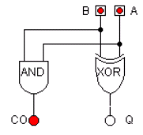
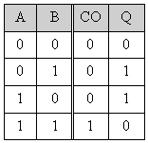
Practical example: Half adder
Adds two bits, A and B
Gets the answer in Q and carry in CO
Q = A XOR B
CO = A AND B

Slide 23
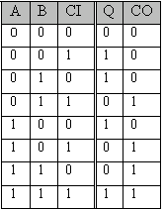
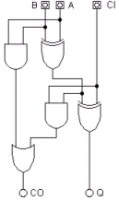
Practical example: Full adder
Adds two bits together, A and B, and possibly CI (carry in)
Gets the answer in Q with carry in CO (carry out)
half adder
half adder
or

Slide 24
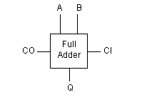
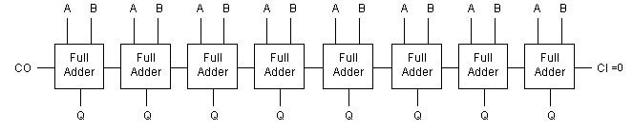
Practical example: 8 bit full adder
Adds 1 bit numbers
’black box’
Full adder
8 bits full adder
8 full adders connected together: Adds 8 bit numbers

Slide 25
Computer architecture

Slide 26
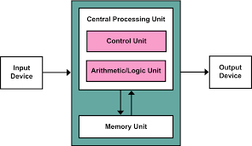
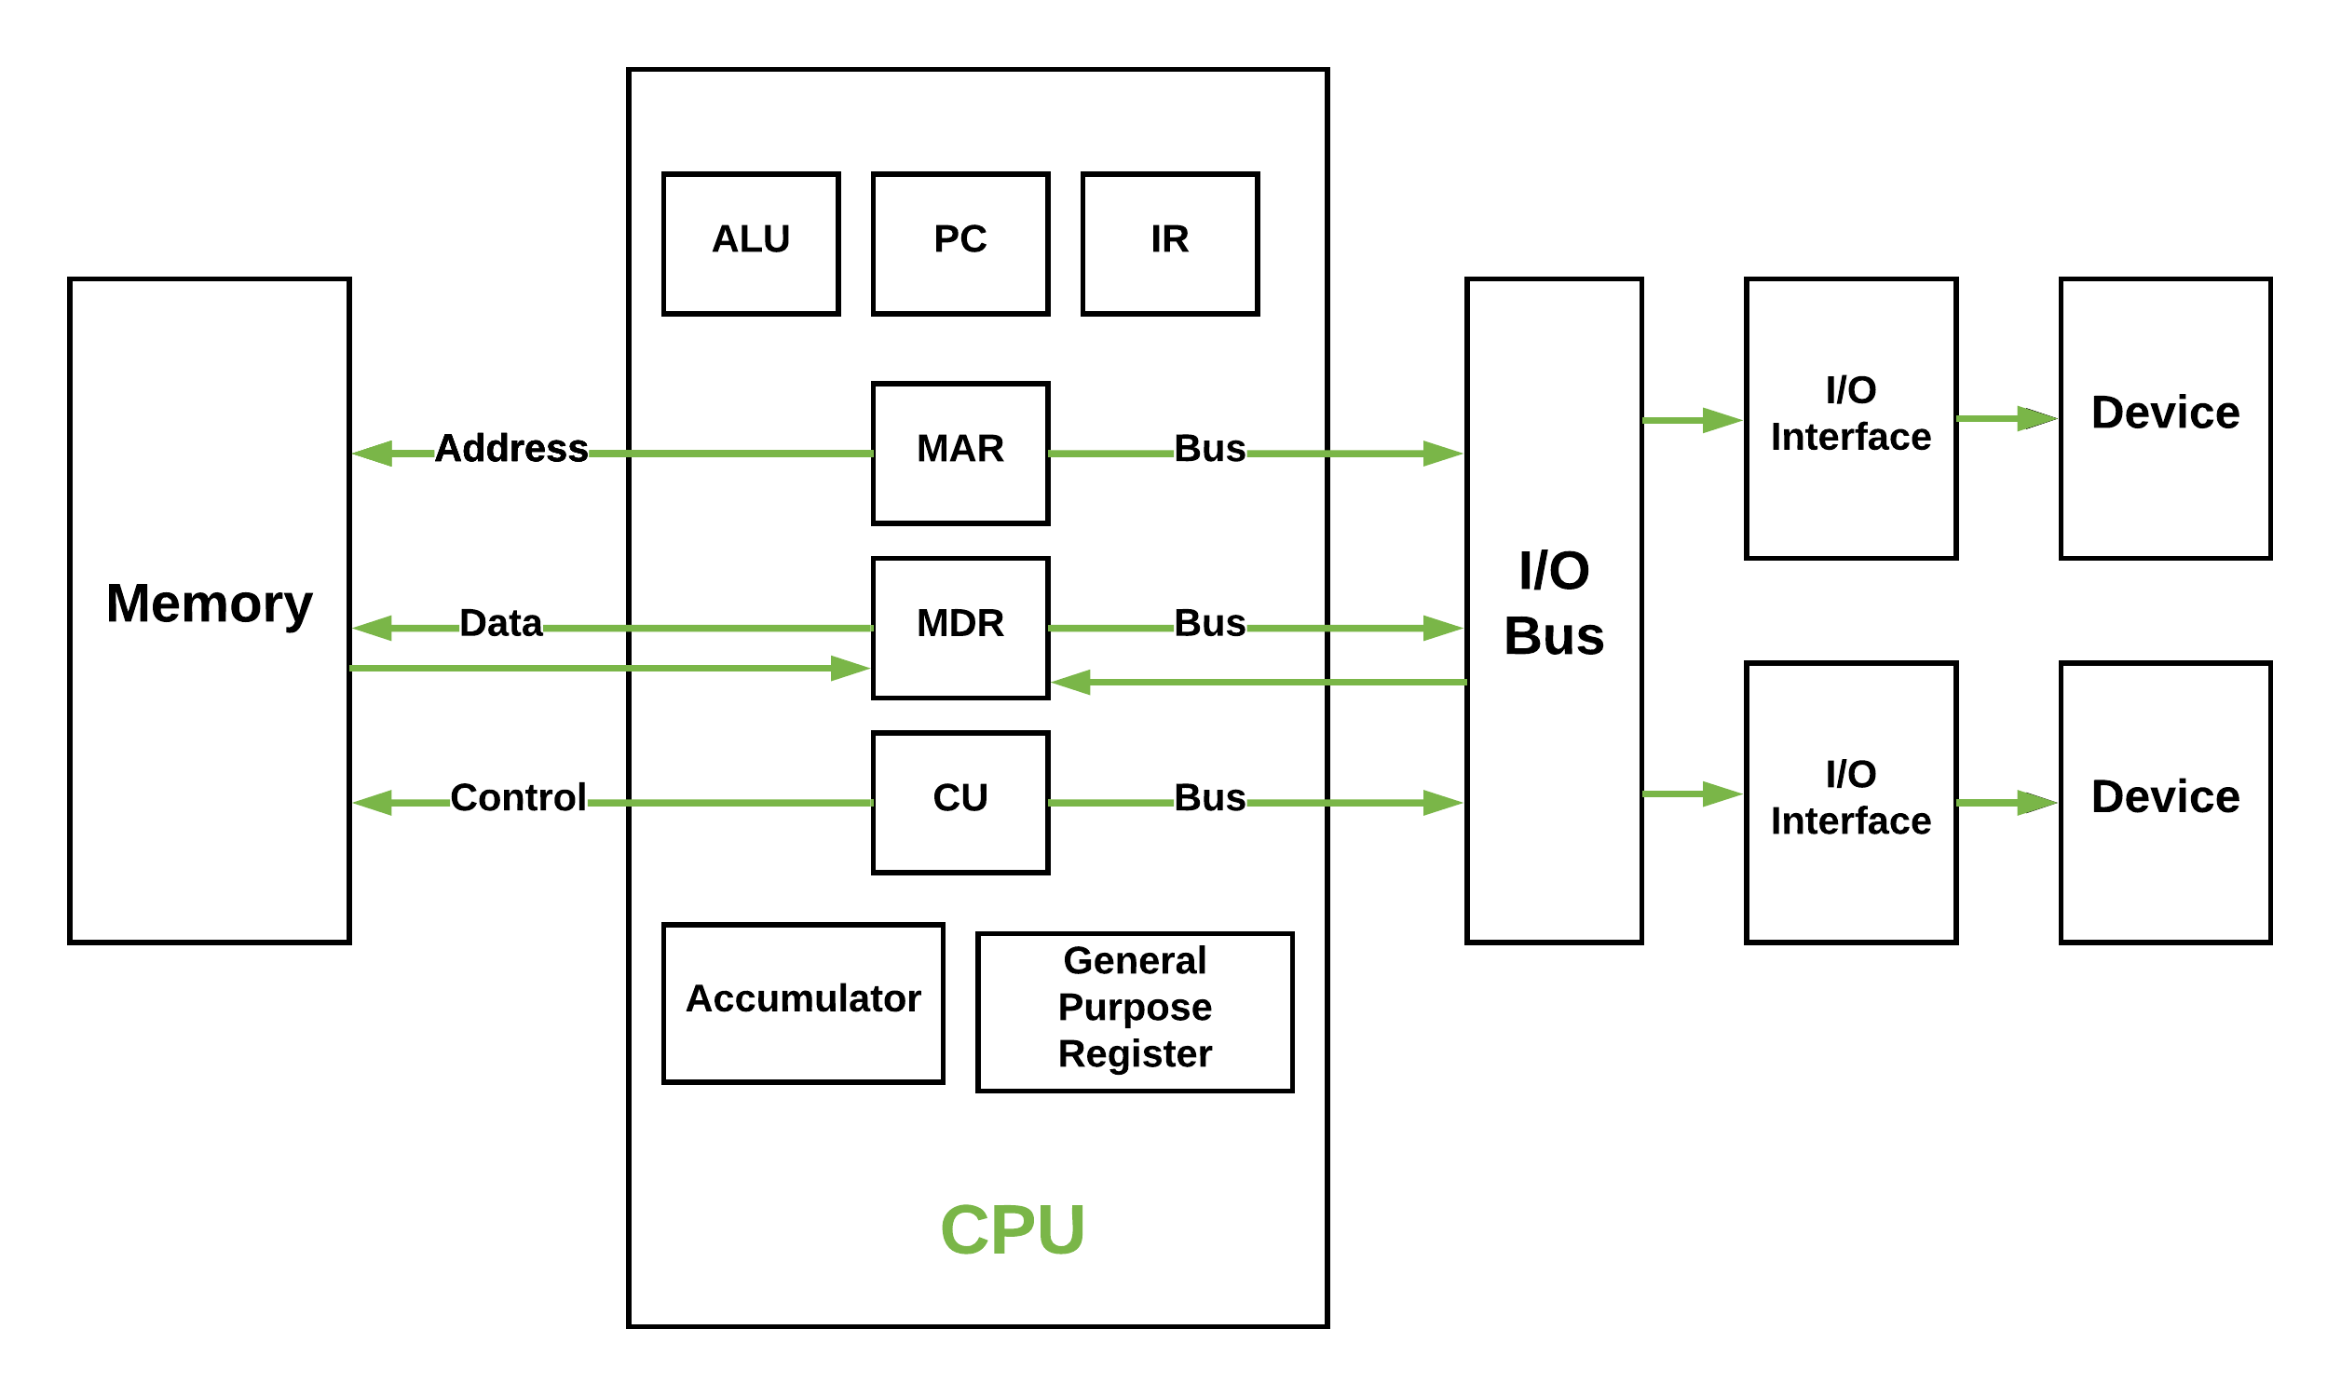
Von Neumann model
https://youtu.be/-SADbPS8UgA

Slide 27
Central Processing Unit
Areas of use
Working speed (clock frequency)
Instruction set (ISA)
Register
Arithmetic Logical Unit and Float Point Unit
Techniques to increase performance: pipelining and parallelization

Slide 28
Processor Classification
Instruction Set Architecture (ISA)
RISC vs CISC
Area of use
Embedded <-> Desktop <-> supercomputers
Clock frequency
Registry file size
Number of functional units arithmetic logic unit (ALU) and floating-point unit (FPU)
Superscalarity and parallelism
Socket-type
Energy consumption and cooling needs

Slide 29
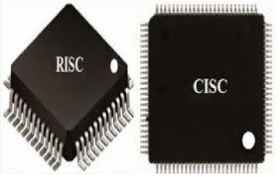
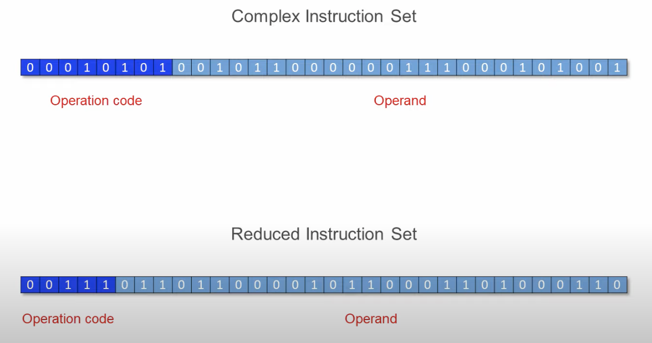
Different Processor (CPU) Design Methodologies
RISC vs CISC
Complex Instruction Set Computing
Reduced Instruction Set Computing
https://www.youtube.com/watch?v=6Rxade2nEjk&t=8s

Slide 30

Binary number representation (recall)
With 3 lamps we can represent 2³ = 8 combinations of on / off
With Off = 0 and On = 1 we get
0 = 000 4 = 100
1 = 001 5 = 101
2 = 010 6 = 110
3 = 011 7 = 111
This can be extended to use more lamps
(transistors), e.g. 8, 16, 32, 64, ....

Slide 31
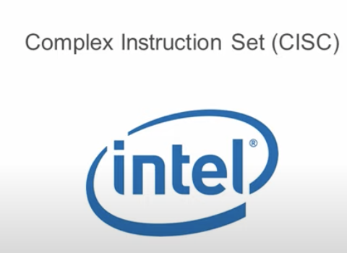
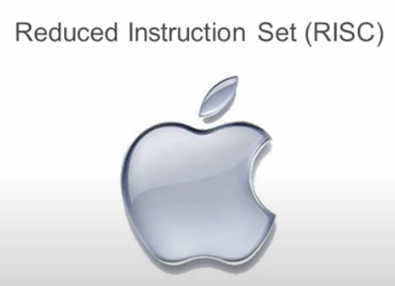
Manufacturers-Instruction Set Architecture (ISA)
Mac book pro intel
Intel (x86) and AMD
Complex Instruction Set Computing
Constructs and produses CPU, chipset etc.
Focus: Desktop, server, mobile, embedded.
MIPS(32 registers) and ARM (16 registers)(apple)
Reduced Instruction Set Computing
Constructs and licenses CPU cores etc. to various manufacturers
Focus: Embedded, mobile
Now x86 and ARM processors bothe have features of RISC and CISC
other Mac apple M1 ARM
https://www.youtube.com/watch?v=6Rxade2nEjk&t=8s
Notes:
MIPS and ARM are two different instruction set architectures in the family of RISC instruction set. Although both the instruction sets have a fixed and same instruction size, ARM has only 16 registers while MIPS has 32 registers
Mac book pro : intel
The other Mac book pro : apple M1 ARM
Better for AI
Martix multiplication easier and internal that is useful in ML
Old apple were ARM but now they also have Intel
And ARM in apple m1 for example
Both the ‌M1‌ and ‌M2‌ are configurable with 8GB or 16GB of unified memory, but the ‌M2‌ offers an additional 24GB top-tier memory option. Multitasking and memory-hungry workflows, such as working with large assets, benefit from the higher memory option as a result.

Slide 32
Area of use
Embedded systems
IoT Devices
Supercomputer
Mobile phones use simple and "cheap" CPUs.
Desktop and Laptops
Notes:
Most Arduinos (ARM, etc) are considered RISC
The supercomputer Astra, made by Hewlett Packard Enterprise, is the largest ARM-based supercomputer to be used by the Sandia National Laboratory for nuclear research (Engadget).
Supercomputer located at Oak Ridge National Laboratory uses a total of 9,216 IBM POWER9 processors which use the Power Instruction Set Architecture, which is based upon RISC.

Slide 33
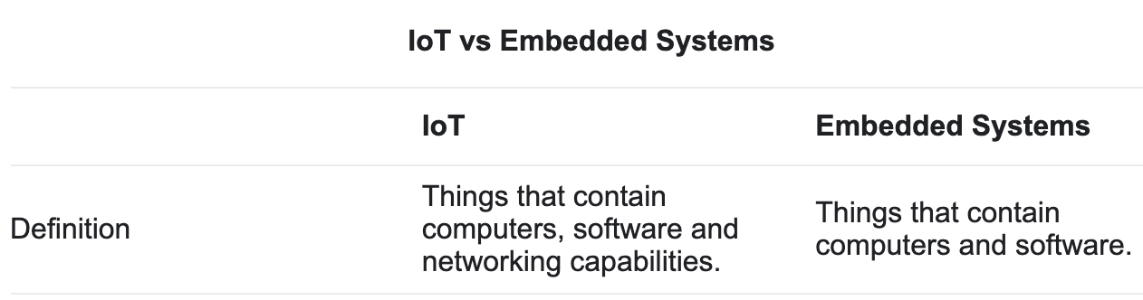
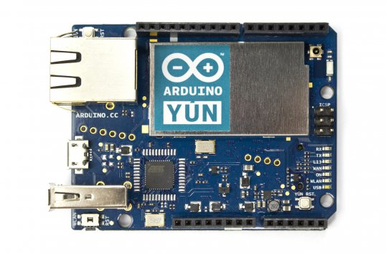
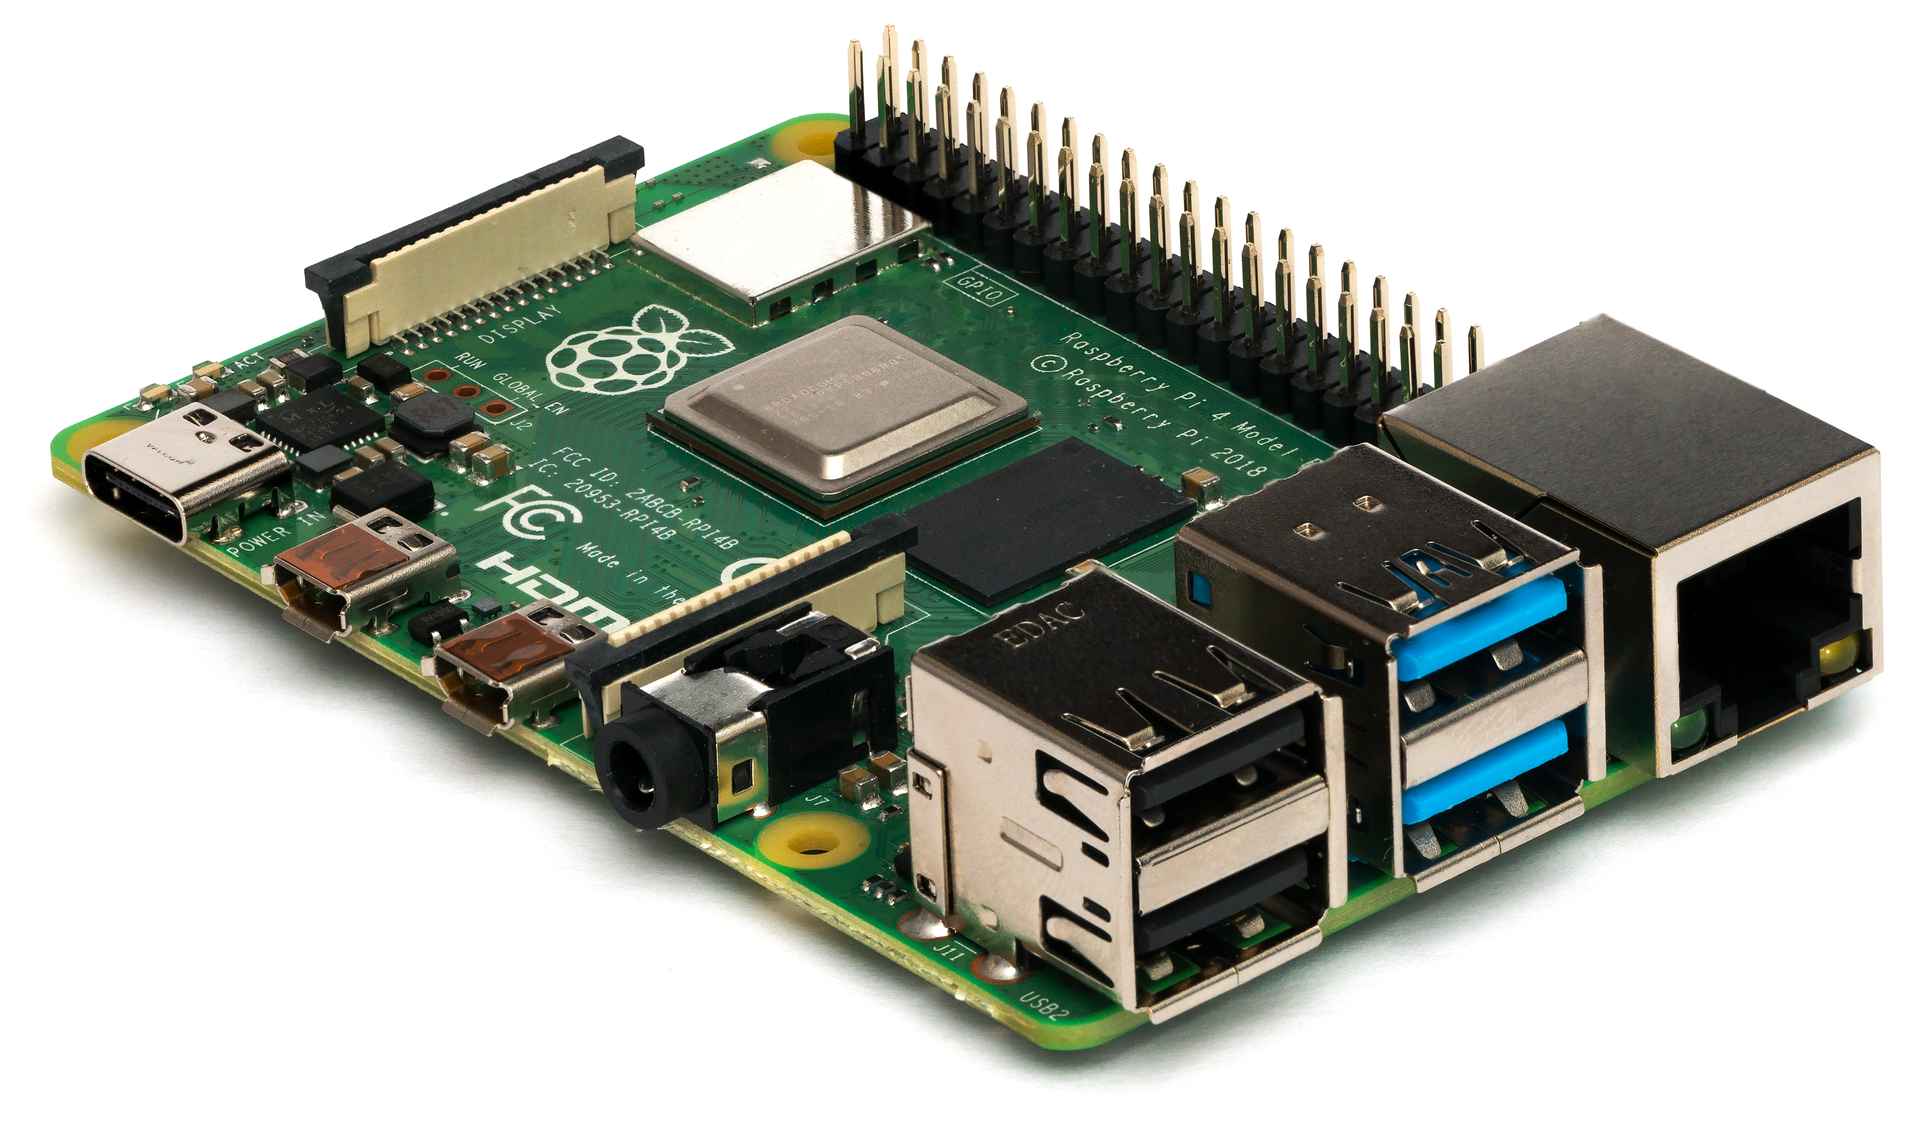

Embedded and IoT systems
Made for specific purposes
Controlled by a microprocessor /- controls
The software is ready-made, often a single program, and is usually in firmware.
Can be configured frequently.
Does not (often) need OS.
Example
Washing machines, home routers, clock radios, guitar tuners, smart cards, SIM cards,…
In the last couple of years, the Arduino and Raspberry Pi have opened up for much simpler home development of various embedded systems.
https://www.youtube.com/watch?v=p40OetppIDg
Notes:
A Global System for Mobile Communication Subscriber Identity Module, or GSM SIM card, is a SIM card that uses the GSM network. Having this card in an unlocked cell phone while using the correct frequency allows a cell phone user to use his cell phone in various countries all over the world.
5g 4g now
gsm old
https://www.translatorscafe.com/unit-converter/ku-IR/data-storage/29-19/exbibyte-gibibyte/

Slide 34

Supercomputers
Tianhe-2
3.120.000 cores
33.863 Tflop/s
17.808 kW
1.024.000 GB RAM
Kylin Linux
The world's largest and fastest: CHINA
Kilde: http://top500.org/
Notes:
China's Tianhe-2 is now the world's fastest super computer, with speeds reaching up to 30.65 petaflops (full capacity - 54.9 petaflops); 74 percent faster than the current record holder Cray XK7 system-based Titan at the Oak Ridge National Laboratory in the US. Ars Technica, the technology magazine reported. And it was not even running at its full capacity! The machine runs on Kylin Linux, an operating system developed by teams at the National University for Defense Technology, and is built of a staggeringly large system. There are 32,000 Intel Ivy Bridge Xeon sockets and 48,000 Xeon Phi boards for a total of 3,120,000 cores. Titan is a supercomputer built by Cray at Oak Ridge National Laboratory for use in a variety of science projects. Titan is an upgrade of Jaguar, a previous supercomputer at Oak Ridge, to use graphics processing units (GPUs) in addition to conventional central processing units (CPUs), and is the first such hybrid to perform over 10 petaFLOPS. The upgrade began in October 2011, commenced stability testing in October 2012 and it became partially available to researchers in early 2013. The initial cost of the upgrade was US$60 million, funded primarily by the United States Department of Energy. Titan has AMD Opteron CPUs in conjunction with Nvidia Tesla GPUs to improve energy efficiency while providing an order of magnitude increase in computational power over Jaguar. It uses 18,688 CPUs paired with an equal number of GPUs to perform at a theoretical peak of 27 petaFLOPS; however, in the LINPACK benchmark used to rank supercomputers' speed, it performed at 17.59 petaFLOPS. This was enough to take first place in the November 2012 list by the TOP500 organisation. Titan is available for any purpose; however, selection for time on the computer depends on the importance of the project and its potential to fully utilise the hybrid architecture. Any selected code must also be executable on other supercomputers to avoid dependence solely on Titan. Six "vanguard" codes were selected to be the first to run on Titan dealing mostly with molecular scale physics or climate models, while 25 others are also queued for use of the machine. Due to the inclusion of GPUs, programmers have had to alter their existing code to properly address the new architecture. The modifications often require a greater degree of parallelism as the GPUs can handle many more threads simultaneously than CPUs and the changes often yield greater performance even on CPU-only machines.

Slide 35

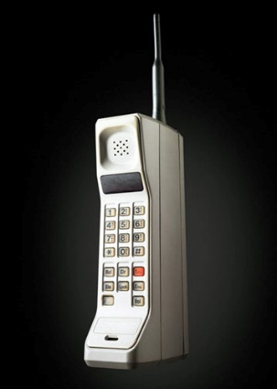
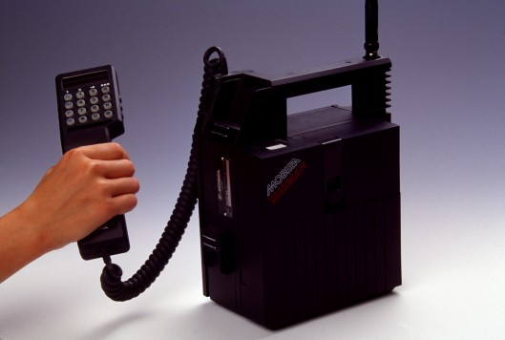
Mobile phones
Traditionally, mobile phones use simple and "cheap" CPUs.
ARM or MIPS ISA and core
The mobile manufacturers then produce custom versions themselves.
Intel has ambitions in the market.
"Smart phones" are (perhaps) most similar to a full-fledged PC with its own GSM card
Notes:
A Global System for Mobile Communication Subscriber Identity Module, or GSM SIM card, is a SIM card that uses the GSM network. Having this card in an unlocked cell phone while using the correct frequency allows a cell phone user to use his cell phone in various countries all over the world.

Slide 36
Desktop ≈ x86
x86
x86 is a generic term for CPUs with the same set of instructions as Intel developed.
Apple started with Motorola 68000 RISC CPU, continued with IBM / Freescale PowerPC CPUs.
Went over to x86 i 2005
Intel and AMD
Still developing the x86 series.

Slide 37
Area of use
Embedded systems
The dominant CPU architecture for embedded
ARM, which is always described as RISC.
Other players are x86 [CISC] and MIPS [RISC].
IoT Devices
Most Arduinos (ARM, etc) are considered RISC
Supercomputer
RISC offers some advantages over CISC and have even been used in the current world’s fastest supercomputer (February 10, 2020).
Mobile phones use simple and "cheap" CPUs.
ARM or MIPS ISA and core
Desktop and Laptops
Notes:
Most Arduinos (ARM, etc) are considered RISC
The supercomputer Astra, made by Hewlett Packard Enterprise, is the largest ARM-based supercomputer to be used by the Sandia National Laboratory for nuclear research (Engadget).
Supercomputer located at Oak Ridge National Laboratory uses a total of 9,216 IBM POWER9 processors which use the Power Instruction Set Architecture, which is based upon RISC.

Slide 38
x86 instruction set (CISC)
Data relocation:
Move data between registers and to / from RAM.
move, push, pop, …
Control transfer:
Perform condition statements (if, while) and method calls
je, jg, jmp, call, ret
Arithmetic / Logic:
Perform operations on data in registers.
cmp, add, sub, inc, mul, imul, not, and, or, xor
Input/Output: in, out
Writing / reading to ports (and memory addresses)
Debug and Interrupt handling:
int, sti, hlt, nop
Floathing point numbers has their own instructions
Single instruction, multiple data (SIMD) vector and matrix instructions.
MMX, 3D Now!, SSE 1-4
Separate instructions for changing the processor state (system)
Notes:
In a system using x86 architecture, the instructions CLI (Clear Interrupt) and STI (Set Interrupt).
Single instruction, multiple data (SIMD) is a type of parallel processing in Flynn's taxonomy. SIMD can be internal (part of the hardware design) and it can be directly accessible through an instruction set architecture (ISA)

Slide 39
Techniques and concepts

Slide 40

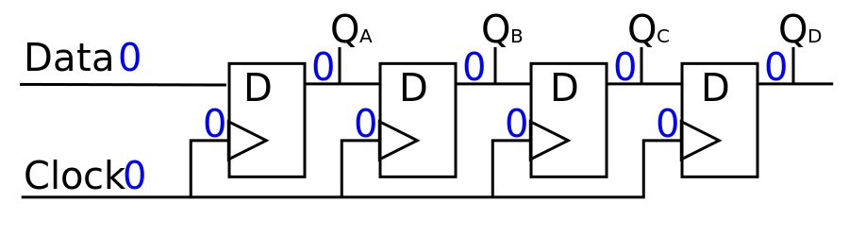
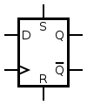
System clocks (Hz)
The system clock keeps steps, does not show the time!
3.2 GHz executes 3.2 billion cycles per second. (Older CPUs had speeds measured in megahertz, or millions of cycles per second.)
full speed ahead.
Notes:
A CPU with a clock speed of
3.2 GHz executes 3.2 billion cycles per second. (Older CPUs had speeds measured in megahertz, or millions of cycles per second.)
Your CPU processes many instructions (low-level calculations like arithmetic) from different programs every second. The clock speed measures the number of cycles your CPU executes per second, measured in GHz (gigahertz).
A “cycle” is technically a pulse synchronized by an internal oscillator, but for our purposes, they’re a basic unit that helps understand a CPU’s speed. During each cycle, billions of transistors within the processor open and close.

Slide 41
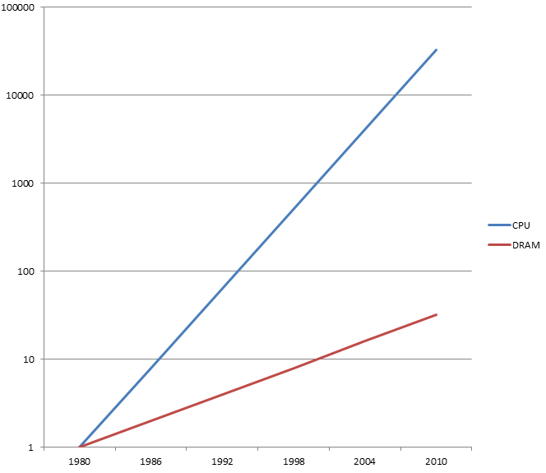
CPU vs RAM (DRAM)
CPU performance / speed have doubled every other year
DRAM performance / speed every six years!
The complete program is in RAM
Only single instructions and single data are on the CPU
-> PROBLEM !!!
The challenge is to keep the pipeline full
Ytelse
År
Notes:
Dynamic random-access memory

Slide 42
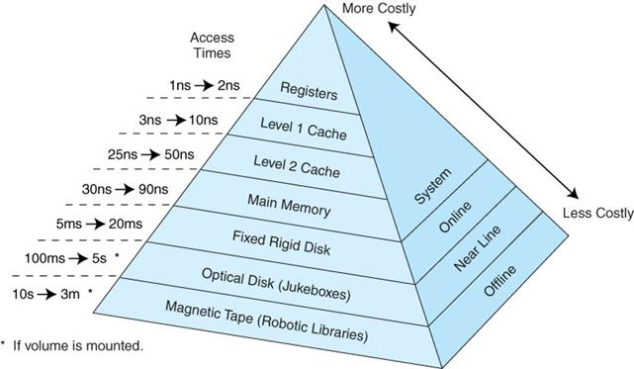
Memory-hierarchy
Doing something in a registry typically takes a clock pulse
Reading / writing RAM typically 150-300.
Notes:
A rigid disk is the name of a disk or disc that is not flimsy like tape. Good examples of rigid disks are the disk platters found in hard drives, CDs, floppy diskettes and Zip diskettes.
Nearline storage is a term used in computer science to describe an intermediate type of data storage that represents a compromise between online storage and offline storage/archiving.

Slide 43
Cache
The locality principle
About 5% of the code is run about 95% of the time.
Instructions to be executed are stored in the order in which they are going to be executed.
Cacheing takes advantage of this by caching the most recently read instructions
Examples: keeping loops make it easy to access …
+ Pageing
We typically do not read individual instructions to Cache, but memory blocks of 4 KiB

Slide 44
Cache
In principle
CPU
Transfer to CPU
Not in internal cache
Ask in cache
Cache controller
Ask in memory
Cache
Memory
Transfer to cache

Slide 45
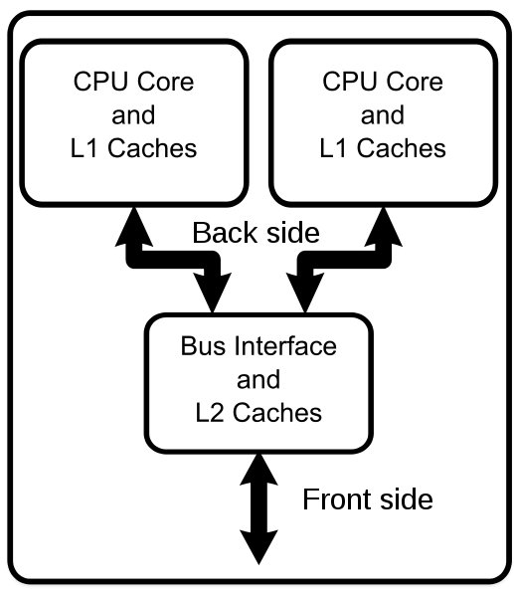
More "cores"
A multi-core processor is a computer processor on a single integrated circuit with two or more separate processing units, called cores, each of which reads and executes program instructions
The instructions are ordinary CPU instructions (such as add, move data, and branch) but the single processor can run instructions on separate cores at the same time, increasing overall speed for programs that support multithreading or other parallel computing techniques.
The CPU contains several full-fledged "sub-CPUs", which can run software in parallel.
you must have programs that can be parallelized and must not be run sequentially!
Diagram of a generic dual-core processor with CPU-local level-1 caches and a shared, on-die level-2 cache
Notes:
^{[2]} Manufacturers typically integrate the cores onto a single integrated circuit die (known as a chip multiprocessor or CMP) or onto multiple dies in a single chip package. The microprocessors currently used in almost all personal computers are multi-core.
What is a Core i3, Core i5, or Core i7 as Fast As Possible
https://www.youtube.com/watch?v=GLSPub4ydiM
Core ix
Multi threading, faster, graphic on board, 2-8 cores in i7,
Cash size,

Slide 46
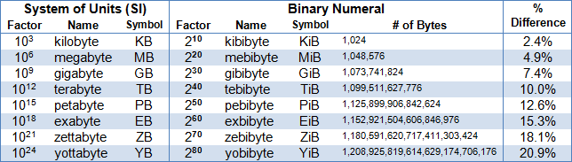
Units and sizes
Bit (b) - 0 or 1
Byte (B) = 8 bits
Kilo = 10³ = 1000 ≈ 1024 = 2¹⁰
1 km = 1000 m, 1 mm = 1/1000 m
For the sake of simplicity, we "cheat" a little!
Heart (Hz) = events per second
MIPS = Mega instructions per second.
FLOPS = Mega floating point operations per second
kbps = 1000 bit / second (bit rate, «bandwidth»)

Slide 47
Differences on x86 16, 32 and 64 bit?
16 bit architecture
16 bit register size (word)
20 bit addressing (max 1 MiB «RAM»)
Segmented addressing (CS: IP e.g)
16 bit words (typically 16 bit int e.g)
No distinction between running kernel code in OS and regular programs.
32 bit (386->Pentium)
32 bit register (word size)
32 bit addressing (4 GiB(gibibyte) Virtual Memory)
Flat and support for virtual memory
32 bit words
Distinguish between kernel and user runtime.
64 bit (now)
64 bit registers and multiple work registers
Typical 48 bit addressing (16 EiB(exbibyte) virtual memory)
Often multi-core
Even more instructions
A mebibyte is equal to 2²⁰ or 1,048,576 bytes. A megabyte is equal to 10⁶ 1,000,000 bytes. One mebibyte equals 1.048576 megabytes.
The relatively small difference between them and so they are often used synonymously.
Notes:
gibibyte
A exbibyte (EiB) is a decimal multiple of the unit byte for digital information or computer storage. The prefix exa (symbol E) is defined in the International System of Units (SI) as a multiplier of 10¹⁸, therefore, 1 exabyte = 10¹⁸ bytes. At the same time, traditionally this metric prefix is used to designate binary multiplier 2⁶⁰, so 1 Ebyte = 1024 Pbytes. The correct prefix for 2⁶⁰ is an exbibyte (EiB), introduced by the International Electrotechnical Commission (IEC) in 1999. Binary prefixes are increasingly used in technical literature, open-source software, and cloud services.
A gibibyte (GiB) is a decimal multiple of the unit byte for digital information or computer storage. The prefix giga (symbol G) is defined in the International System of Units (SI) as a multiplier of 10⁹, therefore, 1 gigabyte = 10⁹ bytes = 1,000,000,000 bytes. At the same time, traditionally this metric prefix is used to designate binary multiplier 2³⁰, so 1 GB = 1024 Mbytes. The correct prefix for 2³⁰ is a gibibyte (GiB), introduced by the International Electrotechnical Commission (IEC) in 1999. Binary prefixes are increasingly used in technical literature, open-source software, and cloud services.

Slide 48
End

Slide 49
Point
CISC
COMPLEX Instruction Set Computer
Many different instructions
Instructions have different lengths in bits / bytes
RISC
REDUCED Instruction Set Computer
Only those instructions that (empirically) are used a lot.
Provides simpler electronics and thus faster execution.
See byte code on JVM.
Moderne Intel/AMD CPU
"both"
CISC externally
RISC microinstructions on the processor itself

Slide 50
More points
The processor executes the instructions in the order in which they are stored in memory («sequentially»).
On different data types completely different instructions are used
7 + 5: mov AX,7 add AX,5 results in 12 being in the AX register
7.0 + 5.0: FLD «The memory address where 7.0 is located» FLD 0012AC45 FADD ST, ST(1) FSTP «the address the answer should be added»
‘Hei’ + ‘Hå!’ loads of instructions that move both strings into the common memory area and add the end cursor (typically ASCII 0x00).

Slide 51
More points
What is a variable??
At the instruction level: the address of a place memory (or a register).
Why do variables have «scope»?
Calling a method means that you start running instructions somewhere else in memory
When you jump back to where the method was called, everything other than what the method returns disappears (typically an address to a value…)

Slide 52
What should we know?
Boolean algebra
NOT, AND, OR, XOR
What an instruction is.
how built up
what types
What a register is.
the types of registers found on the CPU
The difference between address and answer register.
Von Neumann model (again)
smaller «black box»
The difference between CISC and RISC
A little about x86 and options

Slide 53
For optional self-study
For those who want to learn some topics more in depth to better understand, here are some extra topics related to today's teaching, it must be expected some personal work to understand these topics.
There will be no questions on the exam from these, and this is therefore not considered to be part of the syllabus.

Slide 54
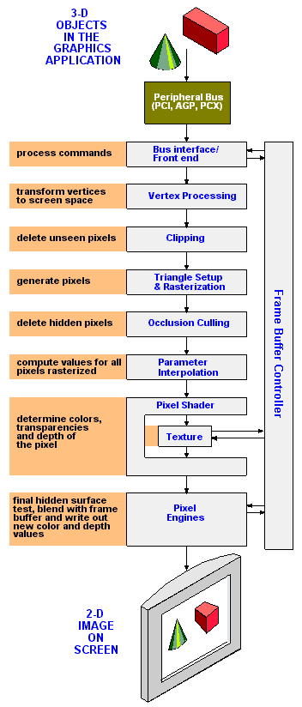
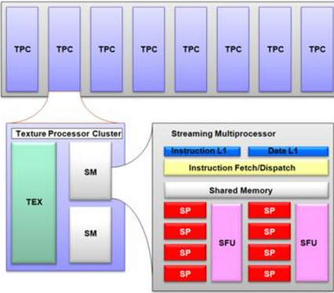
Graphics Processing Unit
Either integrated on motherboard, or mounted on graphics card
Massively parallel
(now) ~ 100s of parallel arithmetic units
Calculates matrices (tables) of floating point numbers
Transforms mathematical models into screenshots (pixels in framebuffer)

Slide 55
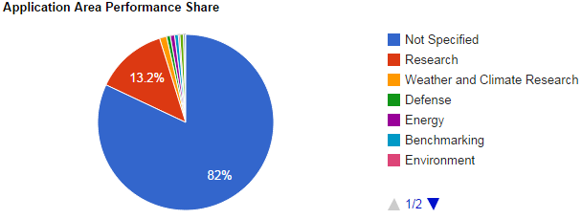
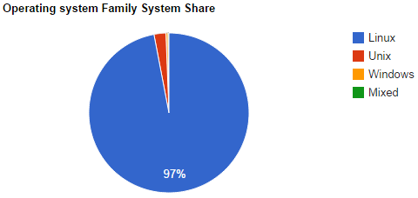

Heavy rain
As of June 2014, there were various Intel Xeon models, which run Linux in Clusters dominate

Slide 56

Software vs Hardware
Applications
Shell + file manager
User programs
Compilers
Hardware
CPU, RAM, I/O-controllers
Peripheral buses
Additional card
Hard disk …
Operating system
Manage access to CPU, Memory, Equipment and files.
Makes it easier to use hardware.
Abstraction layer

Slide 57

Motherboard approx 2004 (?)
Notes:
AGP
BIOS
North bridge
IDE
SATA

Slide 58

Motherboard 2012

Slide 59
Sequential vs. Combinatorial
So far we have only looked at what is called combinatorial logic
Output is determined solely by Input (and time).
Sequential logic also has «memory»
Output is determined by Input and stored bits.
Used i.a. to build register (memory cells).

Slide 60
Boolean as data type
In many contexts, there is no correspondence between the values 0 and 1 and Boolean data types.
Often used for statement logic, where we are interested in "true" and "false", not 1/0
The statement 4 == 4 has truth value true
The statement 3 == 5 has truth value false
How "true" and "false" are actually coded binary is language / compiler dependent.
In Java (and other C-languages) you have different logical operators depending on whether it is truth value or bit-combination you want to perform.
& er bitwise, && are logical
Thus becomes 3&4 = 0 (0011 & 0100 = 0000),
But 3&&4 gives «true», «syntax error», or 4…

Slide 61
Programmering
Bitwise AND writes &
Bitwise OR writes |
Bitwise XOR writes ^
Bitwise NOT writes ~
Logical NOT writes !
Logical AND writes &&
Logical OR writes ||

Slide 62
LET US DESIGN A SIMPLE COMPUTER!
SIMPLE!!! (Understand the principles)
Primitive
We do not make electronics
The machine can still do some things
Further description can be found in Compendium 1

Slide 63
What was architecture again?
How to build the instructions that the computer should execute (execute)
What types of instructions should we have?
How should addressing take place?
Once we have determined the Instruction Set Architecture, we can design a CPU
In practice, this is an interaction between machine design and ISA design
We have a transistor budget

Slide 64
Register
All bits on the CPU must be entered in a register
A register is addressable memory (SRAM) that resides on the CPU.
In Assembly language, the registers typically have their own "names" and roles
The registers used to manipulate variables and values are referred to as work registers.
Example. In X86-64
RIP is the register that contains the address of where in memory the next instruction is to be retrieved from.
RAX is the register most often used to store results in (accumulator)
RCX most often used for countdown (think for-loop)
+ many more (memory processing, driving,…)

Slide 65

PrimRisc v. 0.1 layout
Program Counter Register
Accumulator-based
Only one work register
8 bit addressing
Uses only 5
Load / store
Everything goes via RAM
Single
Can "really" just add
Minne Adresse Register
Instruction Register
Minne Data Register

Slide 66
Register-«file»
PC (Program Counter).
This register will at all times contain the address of the location in the primary warehouse from which the next instruction is to be retrieved.
IR (Instruction Register).
This register stores instructions after they have been retrieved from the primary memory and before being sent to the decoder circuits.
MAR (address register).
When we want to read something from, or put something in the primary warehouse, we must first place the address in MAR.
MDR (data register).
When we do a read operation from the primary memory, the result is placed here. If we are to write to the primary memory, we must first place what we are to write in MDR
ACC (Accumulator).
This register is used primarily in connection with calculation operations. It is also possible to read the contents of a memory address into the accumulator with the instruction LOAD, and save the contents of the accumulator with the instruction STORE.
FLAG register
we need it in order to be able to make conditional jumps (if, while and the like)
The Z flag (Zero flag) is set to 1 if the result of a calculation operation is zero.
The S-flag (Sign-flag) is set to 1 if the result of a calculation operation is negative.
The O-flag (Overflow-flag) is set to 1 if the result of a calculation operation becomes too large (overflow) to fit in the ACC register

Slide 67

Instructions
All instructions are 16 bit (2 bytes)
1 byte to encode
Uses only 4 bits (in this version)
1 byte in the instruction to addresses
Uses only 5 bits (in this version)

Slide 68

Example of a program in memory
/* Load in the accumulator data from address 4, add data from address 5, store at the address located at address 6,
End the run */
Can use a simulator of this architecture (buggy) on today's exercise (Take a look at http://youtu.be/igthwn_qGVI)

Slide 69

Test

Slide 70
Analysis / Criticism of PrimRISC 1
Ready to demonstrate a Fetch-Execute cycle and how instructions can be structured
Missing Pipelining
Poor instruction set
8 against x86-64 sine ~ 1000
Does not support System Programming (OS), multitasking or virtual memory
«Quite small, but still so simple»

Slide 71
Criticism 2
Has support for conditional jumps
Can implement if, for, while etc.
Missing (proper) HW support for methods !!!
In Intel / AMD, this is solved with separate registers (SS and SP) and instructions (call) that support the use of a separate memory area as a stack.
Does not support interupt!
More about this in the upcoming lectures.

Slide 72


Fetch Execute Cycle
Fetch: retrieve instruction from memory and into registry
Decode: Interpret the instruction and set up the circuits that execute it
Execute: Execute the instruction on data / registers (change state)
Store: Save result (back in memory)

Slide 73

Ex: MIPS
INSTR 1
INSTR 1
INSTR 2
INSTR 3
INSTR 4
INSTR 5

Slide 74

Pipelining
Since there are different devices on the CPU that retrieve, decode, execute and store these can be run in parallel ("assembly line")
Can start retrieving a new instruction as soon as it is left for decoding.
In modern Intel / AMD CPU there are «deep and long» pipelines.
15-25 steps ->

Slide 75

Super scale
AMD Athlon hadde tre ALUer og en SIMD flyttallenhet
Superscalarity is a form of parallelization where we have several (parallel) ALU and FPU available on CPU
Can then perform (even) more instructions at the same time!

Slide 76

Pentium (IA32) layout (simplified)
Branch Prediction
«"Guess" which instructions to run afterwards and retrieve them on the CPU»
Cacheing
Instructions in own cache (should never return to RAM!)
Data in own cache

Slide 77

Sandy Bridge
Multiple "cores" -> parallel running of program (threads)
Moved Northbridge (and GPU) «on die»

Slide 78

JVM ISA: Format

Slide 79





JVM: 226 instructions

Slide 80

Example: JVM (Java RunTime Enviroment)

Slide 81


Example: Code and class

Slide 82

Class file (1)

Slide 83

Class file (2)

Slide 84

Byte code

Slide 85
Java byte code vs x86 instructions
Java bytecode can be called a RISC type instruction set
x86 (Intel, as well as AMD) is CISC
The next two files show:
The oldest instructions still included (256 of them, there are many, many more more)
Example of an IA-32 instruction

Slide 86

X86 – Basic Encoding Room

Slide 87





MOV (386->) – mod-reg-r/m
d and w in encoding define the length and direction of the operation

Slide 88

386 Registers (IA32) User Programs

Slide 89

X86-64 register
Very many different registers
-on each core!
Extreme complexity
How do we relate to complexity?
Abstract!

Slide 90
Abstraction
a concept or idea that is not associated with any specific instance
to remove the unnecessary in a given context
to focus on the features that are common
To "hide" complexity
Example:
In a Java program you can hide a complicated program inside a method…
after that you just need to relate to the method
High-level language abstracts away all the machine-complexity
System.out.print ("Hello World!") Actually involves a few thousand instructions since is a method call from java.exe to the operating system's write-to-screen routines.

Slide 91

What is abstraction?
Abstraction is one of the four cornerstones of Computer Science. It involves filtering out – essentially, ignoring - the characteristics that we don't need in order to concentrate on those that we do.
Notes:
https://www.bbc.co.uk/bitesize/guides/zttrcdm/revision/1

